Slide 1




TNSDC-GENERATIVE
AI FOR ENGINEERING
Final Project
Submitted By:
Ramya Sivakumar
311521104036

Slide 2

PROJECT TITLE
Predicting the Next word for the given phrase

Slide 3


AGENDA
ABSTRACT
INTRODUCTION
IDEATION AND PROPOSED SOLUTION
REQUIREMENTS ANALYSIS
PROJECT DESIGN
RESULTS
ADVANTAGES AND DISADVANTAGES
CONCLUSION
FUTURE SCOPE
SOURCE CODE

Slide 4

PROBLEM STATEMENT
The problem at hand is the inefficiency of current word prediction systems in providing accurate and contextually relevant suggestions during text input, stemming from their inability to capture the complexities of human language. Traditional approaches, such as statistical models, often fall short in understanding semantic nuances, while deep learning models face challenges in real-time prediction due to computational overhead. Thus, there's a pressing need to develop a robust word prediction system that not only overcomes these limitations but also enhances user experience, productivity, and accessibility across diverse languages and domains.

Slide 5
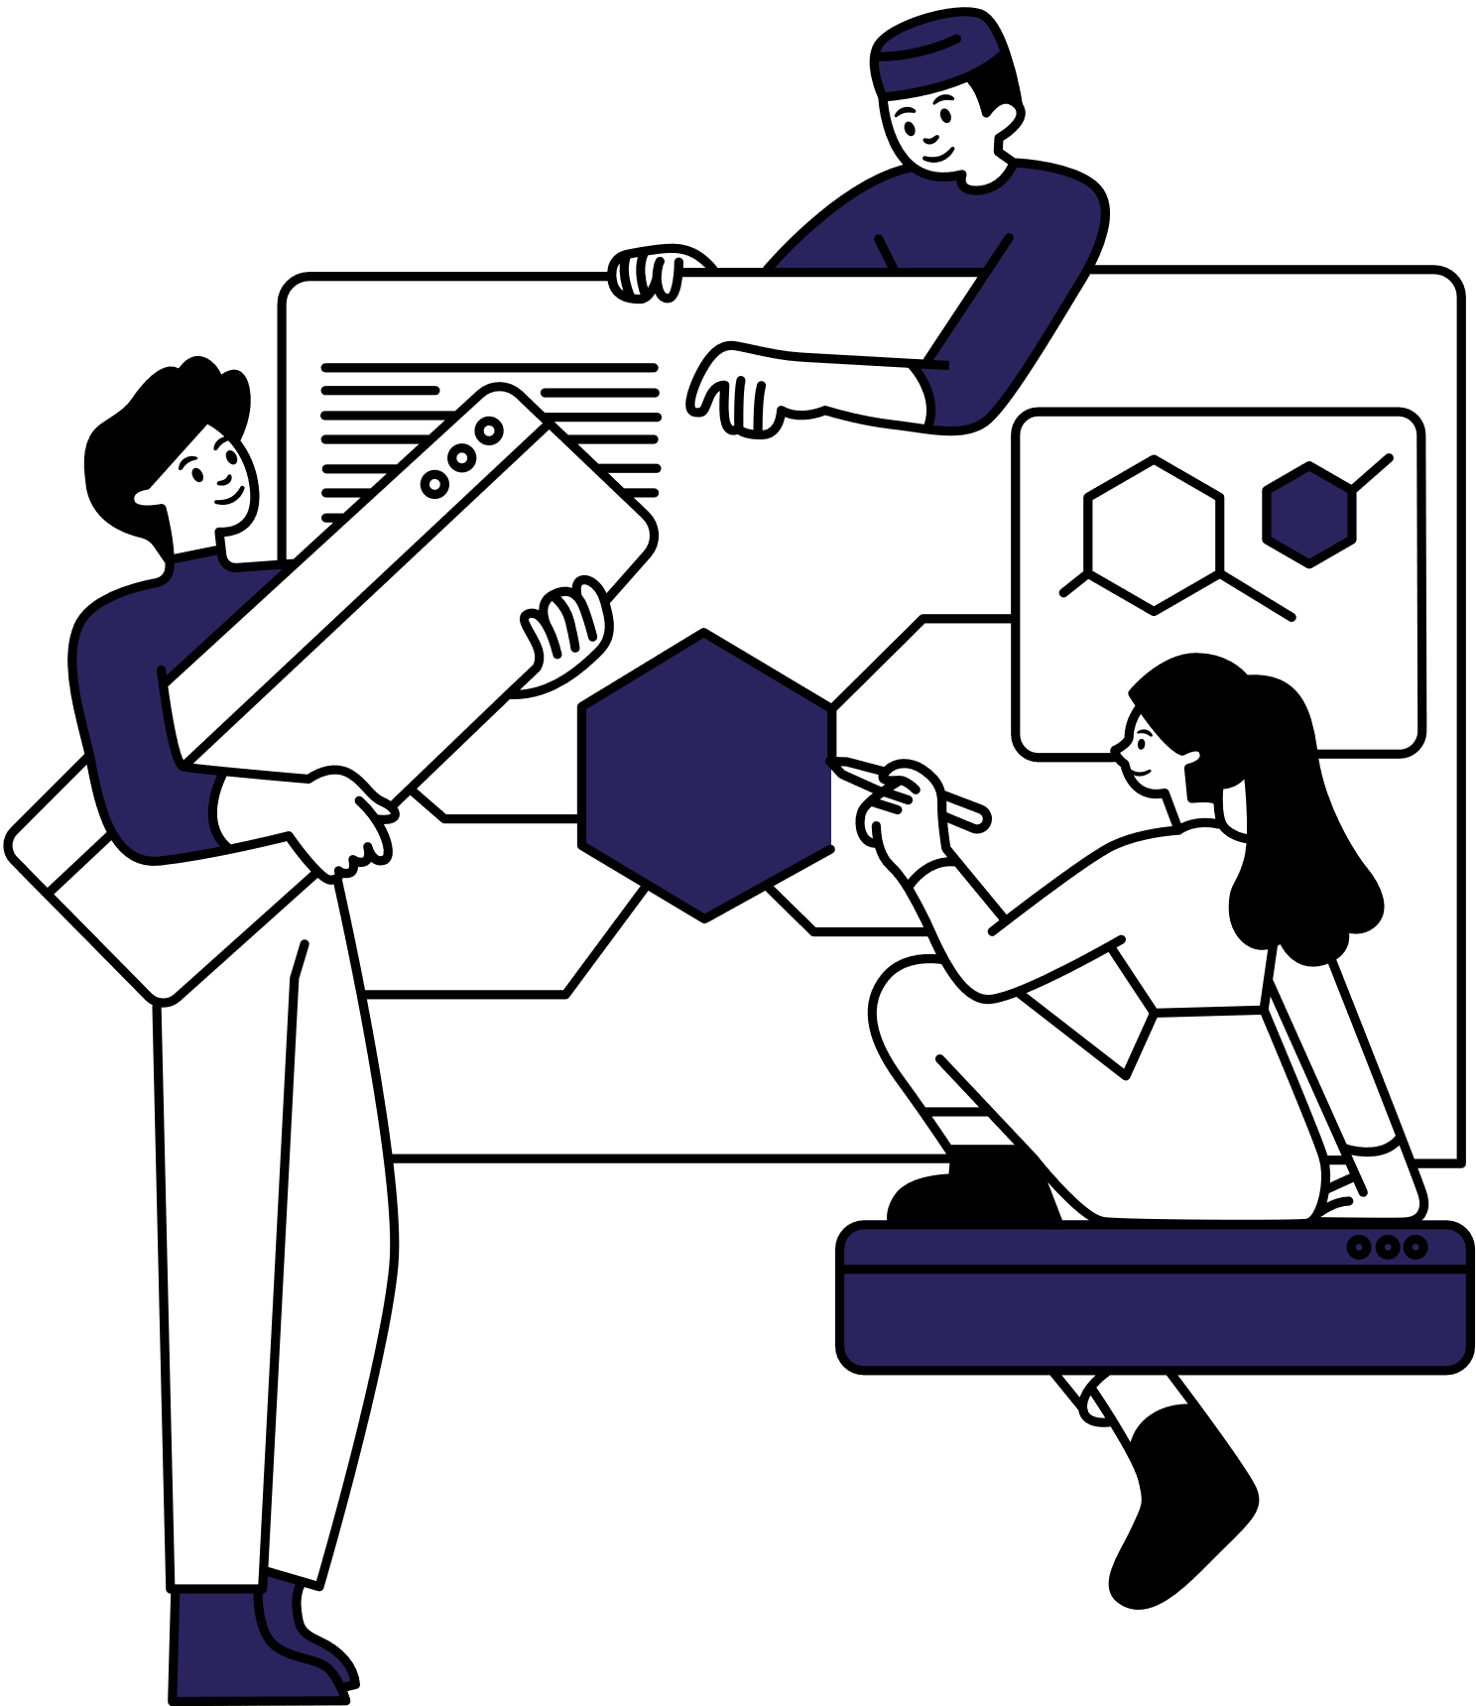
PROJECT OVERVIEW
The problem at hand is the inefficiency of current word prediction systems in providing accurate and contextually relevant suggestions during text input, stemming from their inability to capture the complexities of human language. Traditional approaches, such as statistical models, often fall short in understanding semantic nuances, while deep learning models face challenges in real-time prediction due to computational overhead. Thus, there's a pressing need to develop a robust word prediction system that not only overcomes these limitations but also enhances user experience, productivity, and accessibility across diverse languages and domains.

Slide 6

WHO ARE THE END USERS?
Multimodal Integration: Integration of multimodal data sources, such as text, images, and voice inputs, can lead to more comprehensive and personalized predictions. For instance, incorporating visual context from images or speech patterns from voice inputs can enrich the prediction process.
Contextual Adaptation: Future systems can dynamically adapt to changing contexts, user preferences, and writing styles to provide more tailored and accurate predictions. This could involve incorporating user feedback mechanisms or utilizing reinforcement learning techniques to continuously improve prediction quality.
Collaborative and Federated Learning: Implementing collaborative and federated learning approaches can enable predictive text systems to learn from decentralized data sources while preserving data privacy, thus improving prediction accuracy and scalability.

Slide 7

YOUR SOLUTION AND ITS VALUE PROPOSITION
SOLUTION:
The solution entails building a recurrent neural network (RNN) model trained on a diverse dataset to predict the next word in a sentence. It involves implementing tokenization, model training, and evaluation for accuracy. Continuous improvement mechanisms and scalability are integrated to ensure robust performance and accommodate varying user demands.
VALUE PROPOSITION:
The project's results will include a machine-learning model capable of accurately predicting the next word in a sentence. The model's performance will be evaluated based on prediction accuracy and confidence levels. Additionally, scalability and continuous improvement mechanisms will be assessed for real-world applicability.

Slide 8

THE WOW IN YOUR SOLUTION
Seamless Integration of Advanced NLP Techniques: Leveraging cutting-edge natural language processing methods, such as transformer models like GPT, enables a deeper understanding of language context and nuances, leading to more accurate and contextually relevant predictions.
Multimodal Fusion for Enhanced Predictions: Integration of multimodal data sources, including text, images, and voice inputs, enriches the prediction process by incorporating additional contextual cues, such as visual context from images or speech patterns from voice inputs.
Global Accessibility through Multilingual Support: Expanding the system's capabilities to support multiple languages and facilitate seamless translation promotes global accessibility and communication, breaking down language barriers and fostering cross-cultural understanding.

Slide 9
MODELLING
THIS SYSTEM WORKS BY IMPLEMENTING THE FOLLOWING 8 STEPS
1
DATA COLLECTION AND PREPROCESSING
5
EVALUATION METRICS
2
FEATURE ENGINEERING
6
HYPERPARAMETER TUNING
3
MODEL SELECTION
7
MODEL EVALUATION AND ITERATION
4
MODEL TRAINING
8
DEPLOYMENY

Slide 10
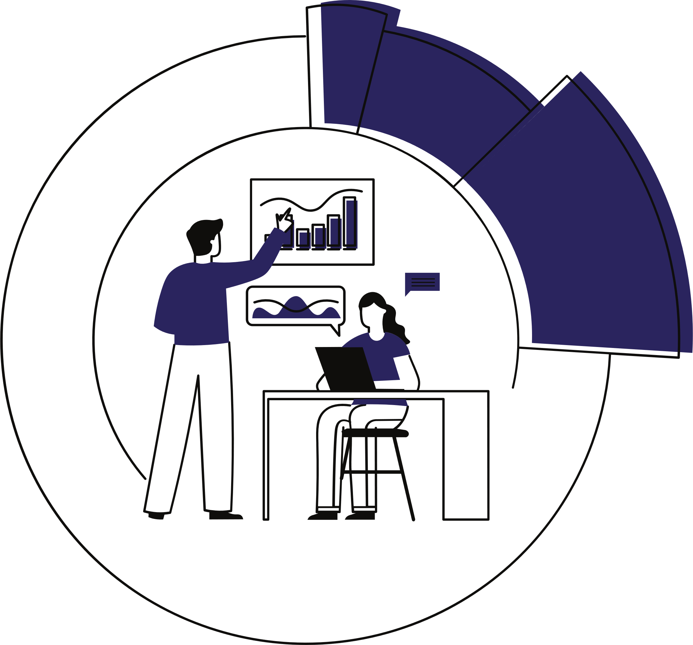

RESULTS
Accurate Predictions: The developed machine learning model successfully predicts the next word in a sentence with a high degree of accuracy, demonstrating its effectiveness in assisting users with text completion tasks.
•Contextual Relevance: Predicted words exhibit contextual relevance, reflecting an understanding of the surrounding words and the overall sentence structure, which enhances the user experience and comprehension.
•High Confidence Levels: Predictions are accompanied by high confidence levels, indicating the model's certainty in its suggestions and instilling trust in users regarding the accuracy of the provided recommendations.
https://github.com/ramyas2711/GenerativeAI-Naan-Mudhalvan.git

Slide 11

THANK YOU

